Slide 1
Group #3
presentation_slides.pdf (Section 5D)
Jaida Langham, Zari McFadden, Margie Ruffin, Ulunma Egwim, and Lelia Hampton
Glass Ceiling & Co.
A Career Portal for Black Women in Corporate
America

Slide 2

Roadmap
What?
The End!
Next Steps
Mission
Demo
Questions
Who?

Slide 3
Mission
Glass Ceiling and Company was founded in 2019 by five seniors at Spelman College in Atlanta, GA who wanted to change the job seeking process as it pertains to black women.
The Glass Ceiling Career portal seeks to spread awareness and educate companies and individuals on the impact of the -isms (racism, sexism, ableism, etc.) while also providing an environment to combat the lack of accessibility, unconscious bias, and lack of transparency when it comes to diversity and inclusion.

Slide 4
Who and what it’s for?
“For Black Women, By Black Women...
but accessible to everyone.”
Our target audience for the Glass Ceiling Career portal are Black women searching for corporate or industry jobs. Although Black women are our target, this website is accessible to any and everyone.

Slide 5

Demo

Slide 6
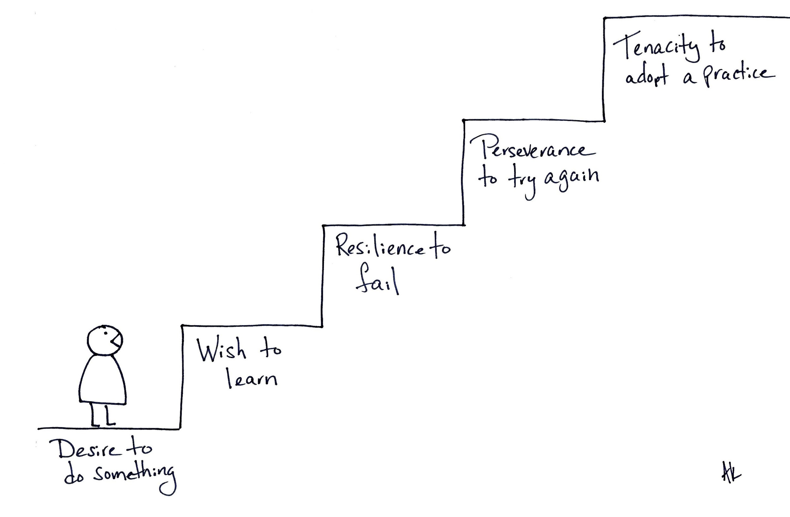
Next Steps
Finish testing
Add dummy data
Merge the back-end and front-end
Complete the rest of the back-end
Solidify the search engine process.

Slide 7
Questions?
Thank you!

